Slide 1


HIV-related stigma and discrimination among health care personnel in Thailand:
Results of the 2017 national surveillance survey
Kriengkrai Srithanaviboonchai MD, MPH
Research Institute for Health Sciences
and Faculty o Medicine,
Chiang Mai University, Thailand

Slide 2
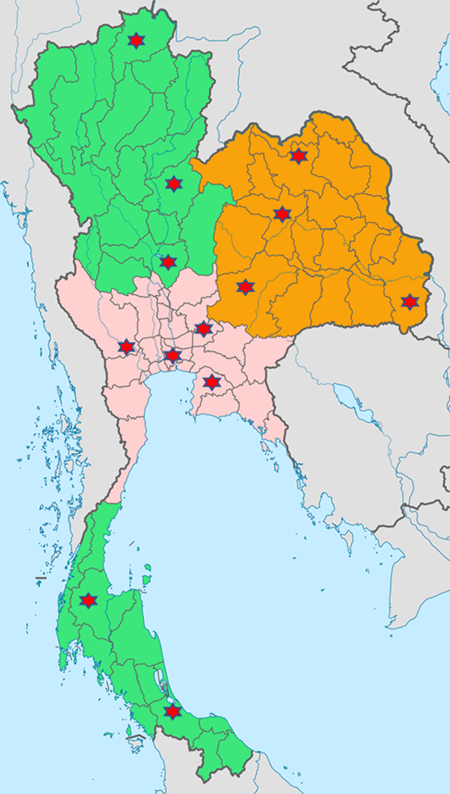
Locations of 13 Thailand’s national surveillance sites on HIV-related S&D in health facilities
2013-2014 Adaptation of global tool to the Thai context and development of survey methodology
First round survey of Thailand’s national surveillance (5 provincial sites) + 12 voluntary provinces
2016 Adaptation of tools and methodology and pilot surveys in Lao PDR and Ho Chi Minh City
2017 Second round survey of Thailand’s national surveillance (13 provincial sites) + 8 voluntary provinces
2019 Third round survey of Thailand’s...

Slide 3
S&D domains measured
among Thai health staff
Actionable drivers of stigma
S&D Domains:
Health Staff
Fear of HIV infection
(3 items)
Negative attitude toward PLHIV
(4 items)
Over protecting oneself
(2 items)
Uncomfortable
Working with
HIV-infected staff
(1 item)
Basic demographics
Health facility policy
(4 items
Observed
discrimination
toward KP
(1 item/group)
Observed
discrimination
toward PLHIV
(2 items)
Manifestations of stigma

Slide 5
Process/cycle and data use for monitoring of HIV-related stigma and discrimination in health care settings in Thailand

Slide 6
Conclusion
The surveillance provided evidence of HIV-related S&D in Thai health facilities.
The information could be used
  as an advocacy tool for policy change and to tailor stigma reducing interventions at the national and local level.
  to monitor the progress toward the target of eliminating S&D in health facilities.

